Slide 1
The Types of Artificial Intelligence and their Impacts on Humanity

Slide 2
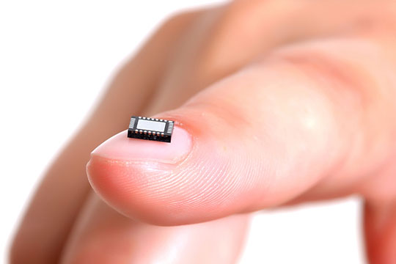
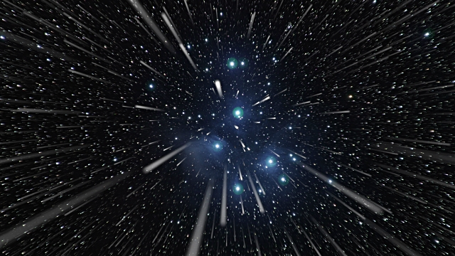
Imagine
End of all disease
Nanotechnology
Intergalactic travel

Slide 3
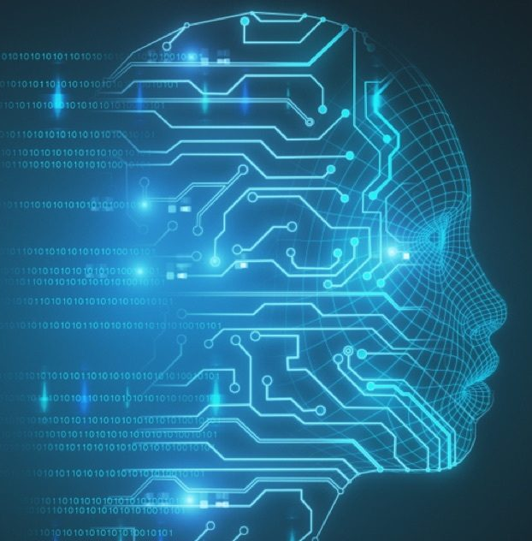
Different Types of AI
Artificial Narrow Intelligence (ANI)
Artificial General Intelligence (AGI)
Artificial Superintelligence (ASI)

Slide 4
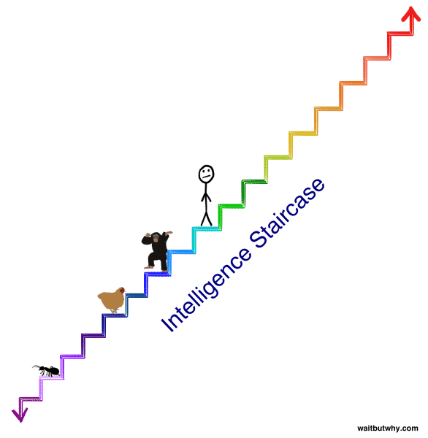
What can they do?
ANI: Chessbot, siri, etc.
AGI: Just like a human, capable of many different things.
ASI: Would create such a massive gap in intelligence, theoretically capable of everything physically possible.
Nick Bostrom - https://highexistence.com/building-god-superintelligent-ai-will-best-last-thing/

Slide 5
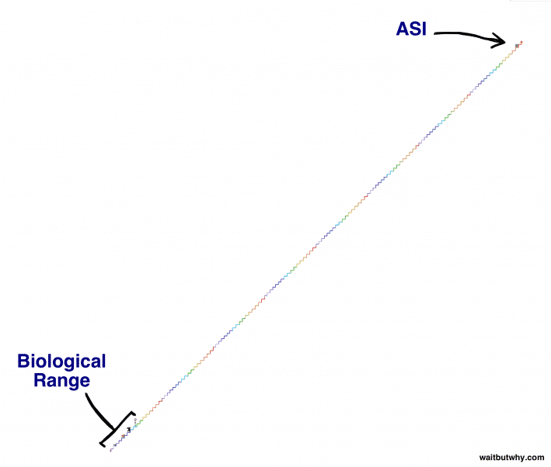
What can they do?
ANI: Chessbot, siri, etc.
AGI: Just like a human, capable of many different things.
ASI: Would create such a massive gap in intelligence, theoretically capable of everything physically possible.
Nick Bostrom -https://highexistence.com/building-god-superintelligent-ai-will-best-last-thing/

Slide 6

What are the dangers?
ANI: Can’t think for itself, poses no real threat on its own.
AGI: Poses a threat if given unfavorable directives.
ASI: Poses an existential threat

Slide 7
Conclusion
AI is a complicated thing.
You now know of the different types, along with the general pros and cons of each
Possibility of a major breakthrough at any moment.

Slide 8
Citations
Brown, Eric. “Building God: Why Superintelligent A.I. Will Be the Best (or Last) Thing We Ever Do.” High Existence, 24 July 2017, https://highexistence.com/building-god-superintelligent-ai-will-best-last-thing/
Goertzel, Ben, editor. Artificial General Intelligence. Springer-Verlag Berlin Heidelberg, 2007, https://link.springer.com/content/pdf/10.1007/978-3-540-68677-4.pdf
Heath, Nick. “What Is Artificial General Intelligence?” What Is Artificial General Intelligence?, ZDNet, 22 Aug. 2018, www.zdnet.com/article/what-is-artificial-general-intelligence/
Goertzel, Ben. “From Here to Human-Level Artificial General Intelligence in Four (Not All That) Simple Steps.” Singularity Hub, 21 July 2018, https://singularityhub.com/2018/07/22/from-here-to-human-level-artificial-general-intelligence-in-four-not-all-that-simple-steps/#sm.0001972fanfmfdb4vjc1odvnxw9tg
Vorhies, William. “Artificial General Intelligence – The Holy Grail of AI.” Data Science Central, 23 Feb. 2016, 3:00 pm, www.datasciencecentral.com/profiles/blogs/artificial-general-intelligence-the-holy-grail-of-ai

